Slide 1
Azure DevOps
by,
Devavrat Kalam (dk2792)
Saurabh Gaikwad (sg4382)

Slide 2
Agenda
What is DevOps
Azure DevOps services
Azure Pipeline
Azure Artifactory
Azure Boards
Azure Repos
Demo
References

Slide 3
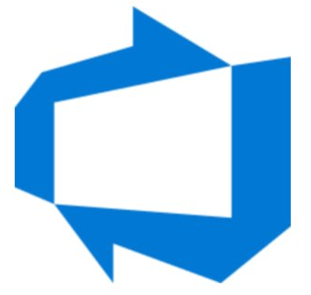
What is DevOps
DevOps is the practice of operations and development
engineers participating together in the entire service lifecycle,
from design through the development process to production support.
In simple terms, DevOps allows us to modify, test, deploy and maintain our codebase rapidly with ease.

Slide 4
Goals of DevOps
Reliability
Scale
Improve deployment frequency
Lower failure rate of new releases
Improved Collaboration
Security

Slide 5
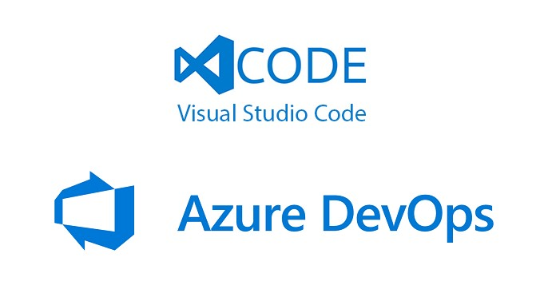
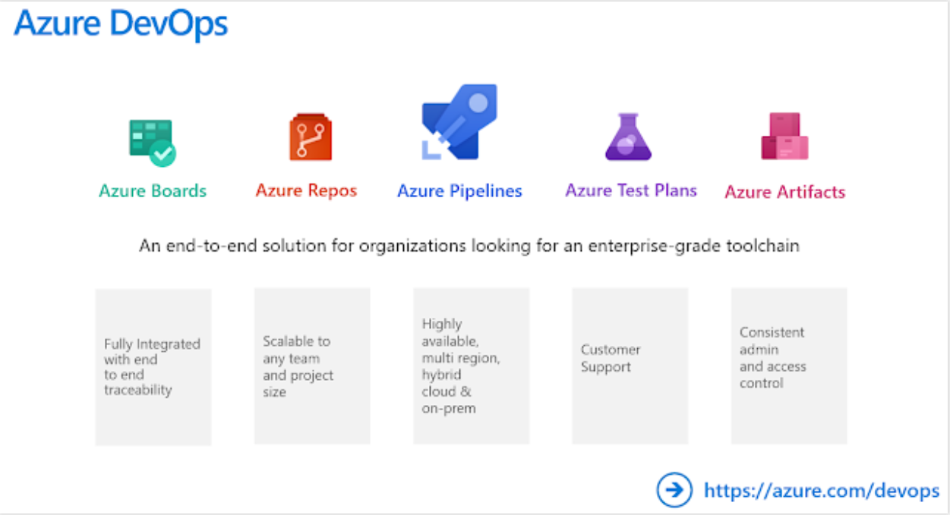
Azure DevOps Services

Slide 6
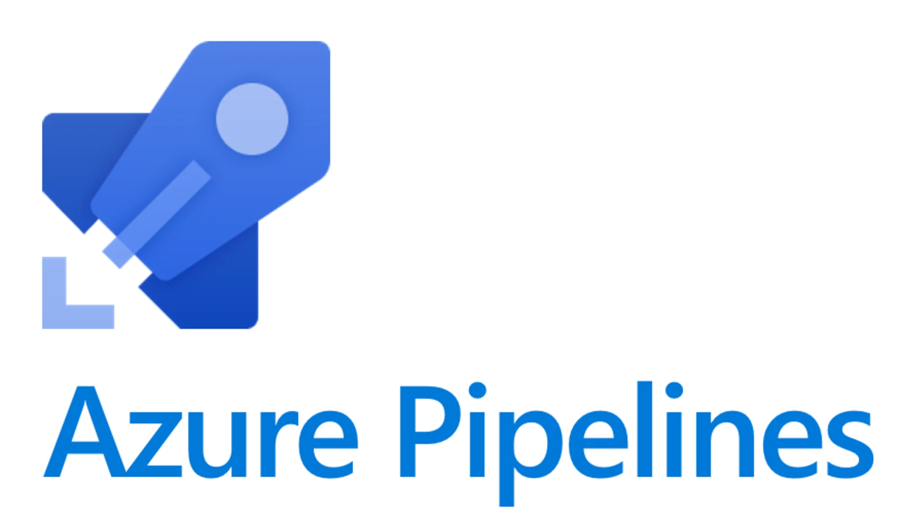
Azure DevOps
Pipelines

Slide 7
Pipelines
Azure Pipelines is a cloud service that can be
used to automatically build and test your code
project and make it available to other users.
Azure Pipelines provides Continuous Integration(CI) and Continuous Delivery(CD) features which allows us to constantly perform changes to codebase, test them and deliver to any target.

Slide 8
Key features
Works with any language or platform
Deploys to different types of targets at the same time
Builds on Windows, Linux, or Mac machines
Integrates with GitHub
Works with open-source projects.

Slide 9
Azure Pipeline Demo
Creating your first Pipeline

Slide 10
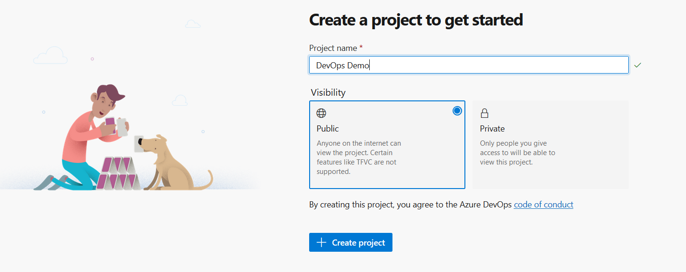
Create a Azure account from https://azure.microsoft.com/en-us/free/
Create a new Organization https://go.microsoft.com/fwlink/?LinkId=307137
Create a project which you want to work on either Public or Private

Slide 11
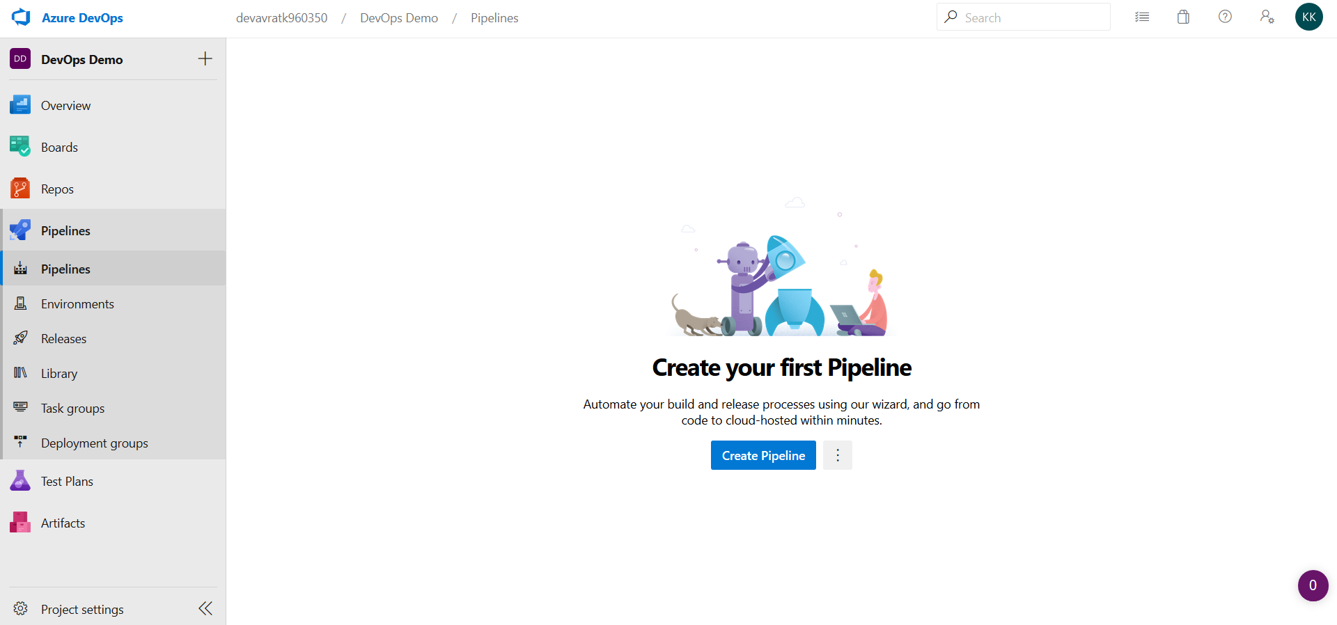
A new workspace will be created for this project. Select Pipelines tab to see all options which can be used in Azure. Click “Create a Pipeline”. Follow the process explained in report.

Slide 12
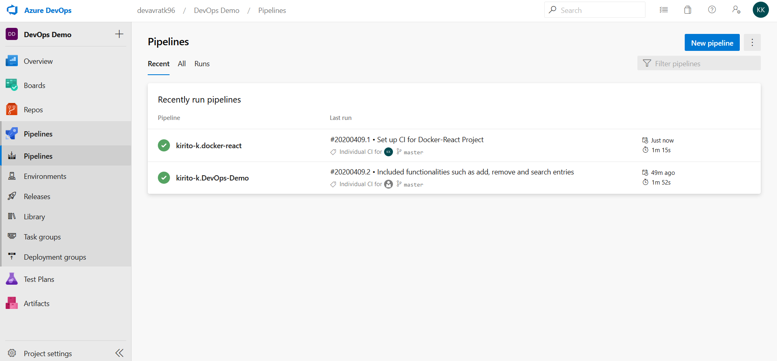
After pipelines have created, we can see the list of projects for which we have built Pipelines.

Slide 13
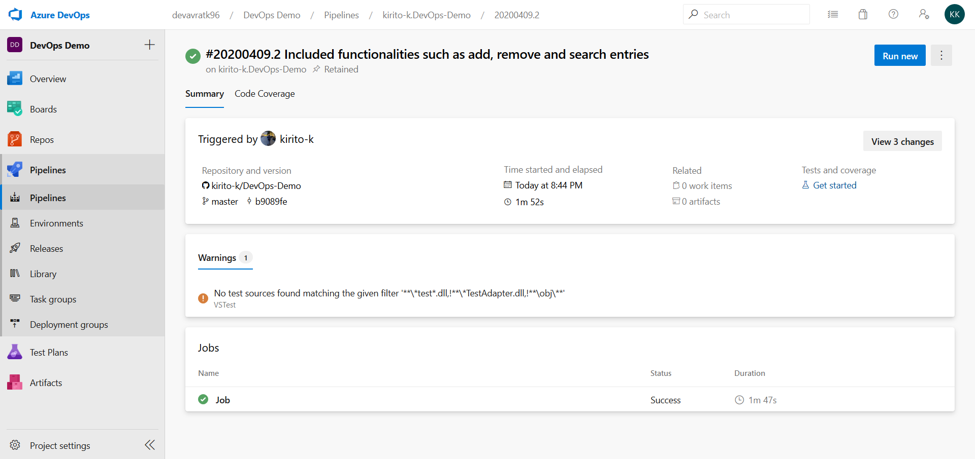
We can also see detailed reports of a particular run by selecting it.
Detailed steps are provided in the Report

Slide 14
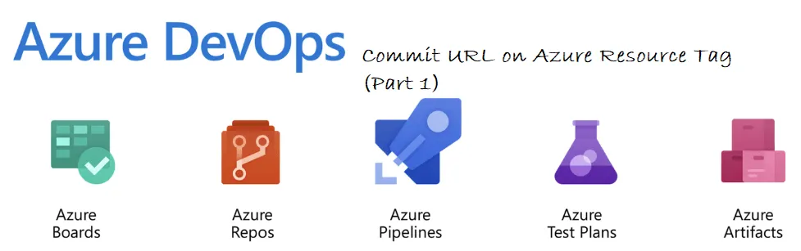
Azure DevOps
Artifacts

Slide 15
Artifacts
Create and share Maven, npm, NuGet, and Python
package feeds from public and private sources
Azure Articants features sharing of code efficiently, managing all package types and add packages to our pipelines.

Slide 16
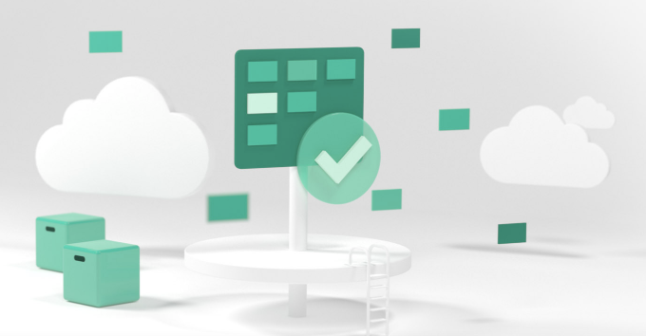
Azure DevOps
Boards

Slide 17
Azure Boards
Azure Boards is a service for managing the work for your software projects. Teams need tools that flex and grow. Azure Boards does just that, bringing you a rich set of capabilities including native support for Scrum and Kanban, customizable dashboards, and integrated reporting. Boards in general is an agile tool to plan, track, and discuss work across your teams.
Why do we need boards?
Working on a software project there are issues to track, manage and prioritize.
To tackle those issues we use Boards.

Slide 18
Azure Boards Demo
Creating custom Board and running query

Slide 19
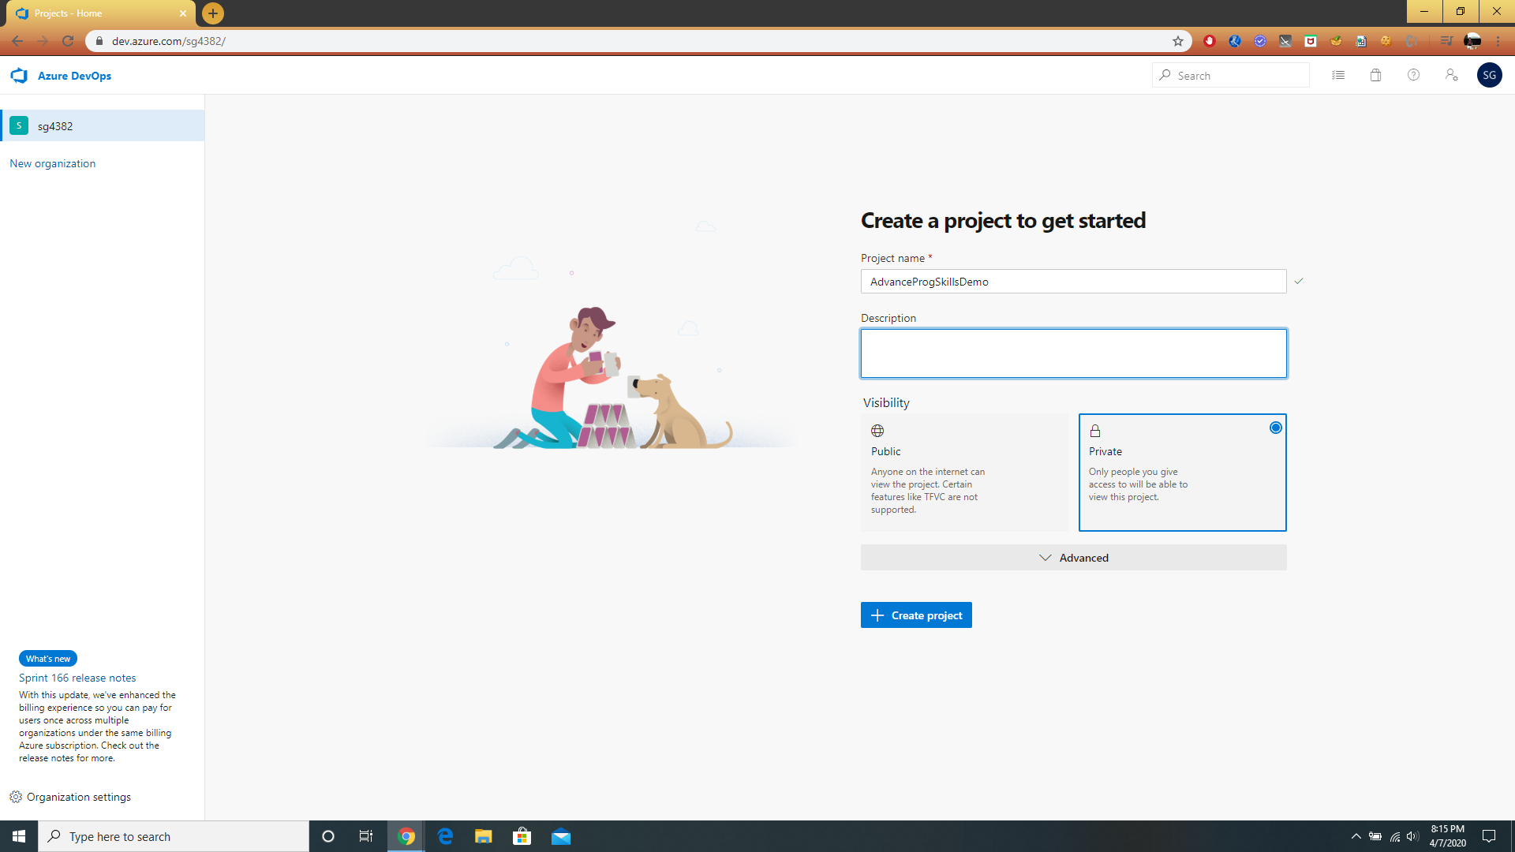
Creating a project.

Slide 20
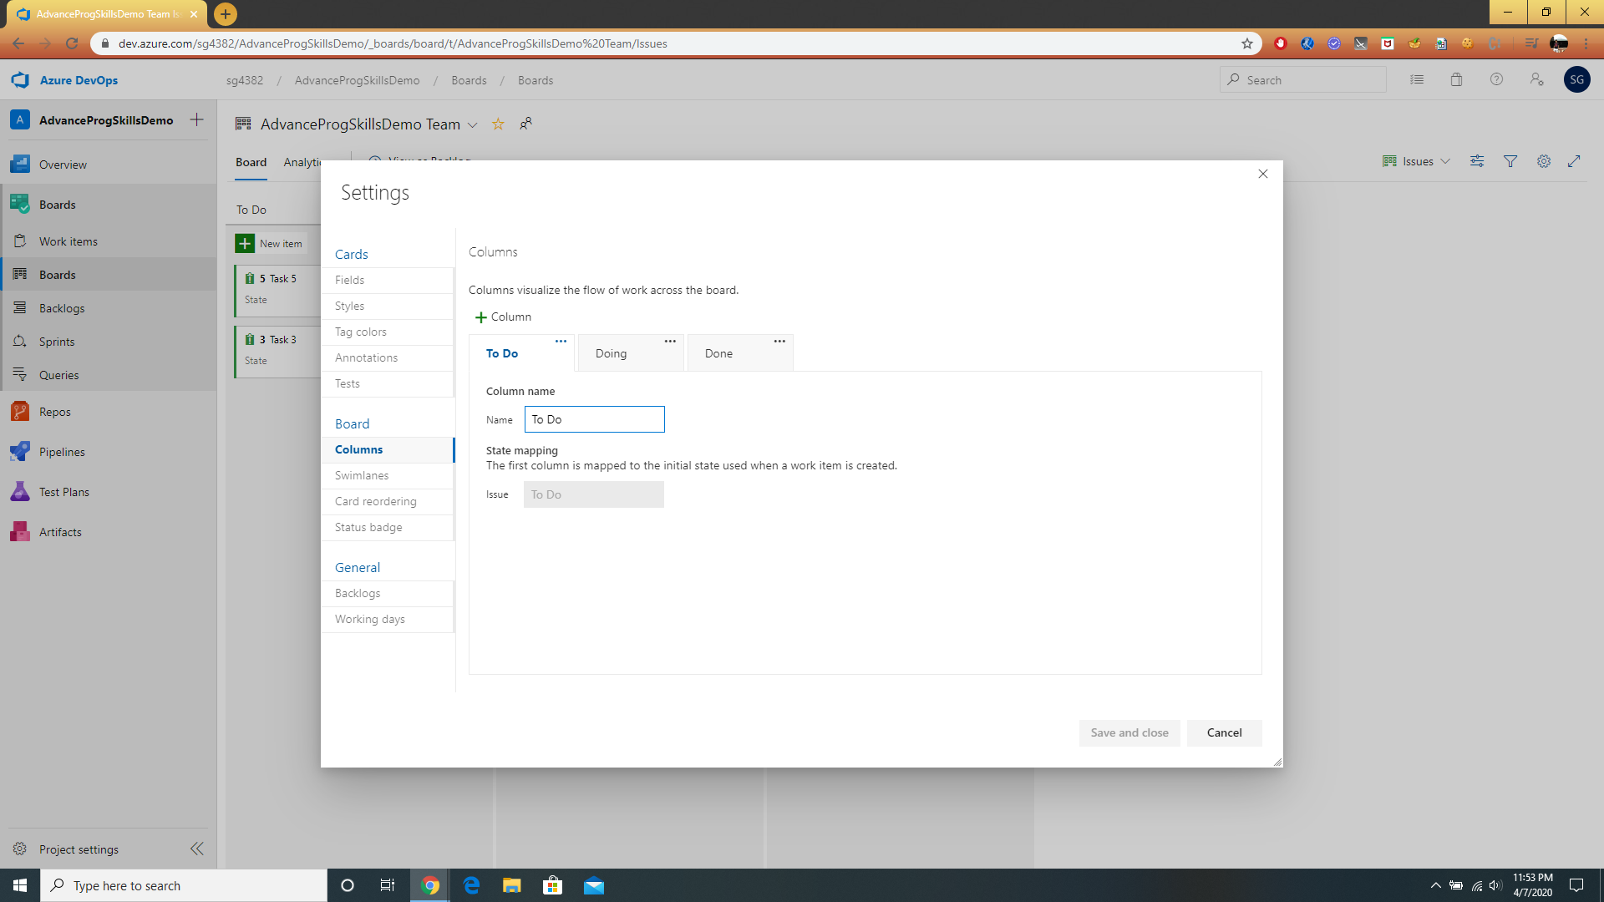
Adding Column to Boards.

Slide 21
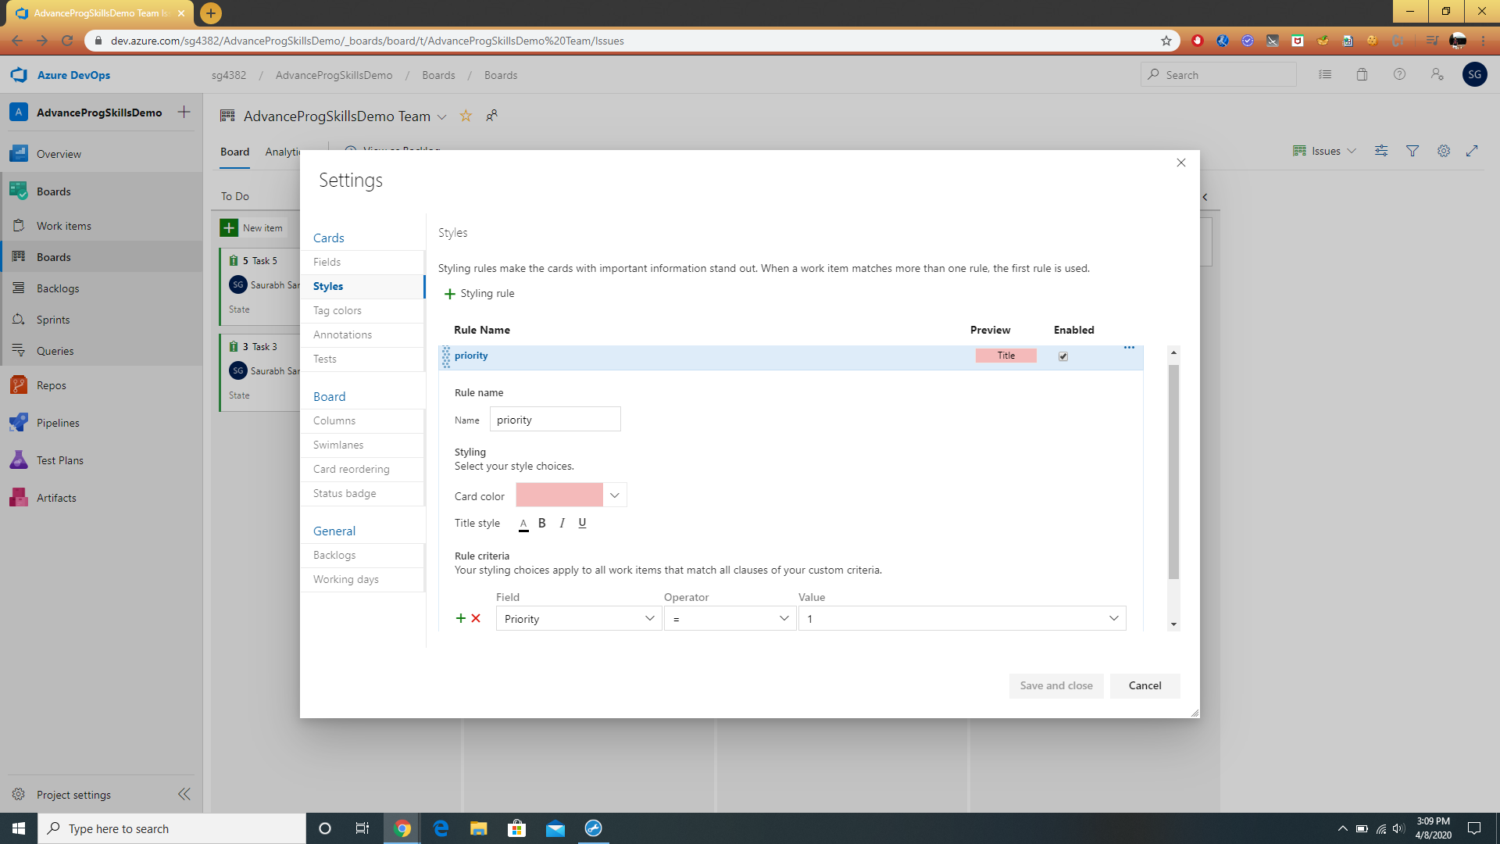
Customizing task as priority.

Slide 22
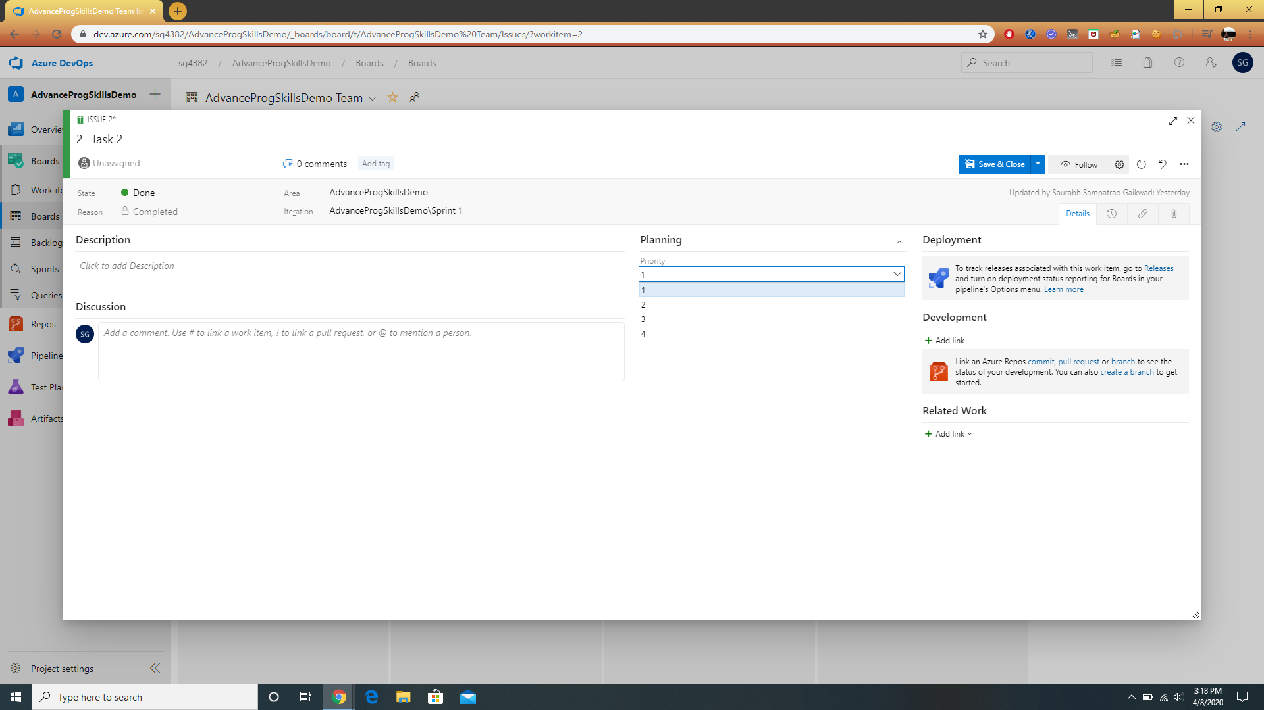
Edit the Priority option under Planning. The Rules we make, their option comes under planning.

Slide 23
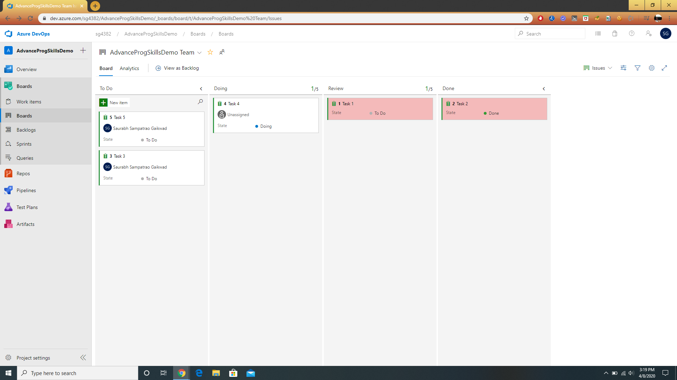
Changed color.

Slide 24
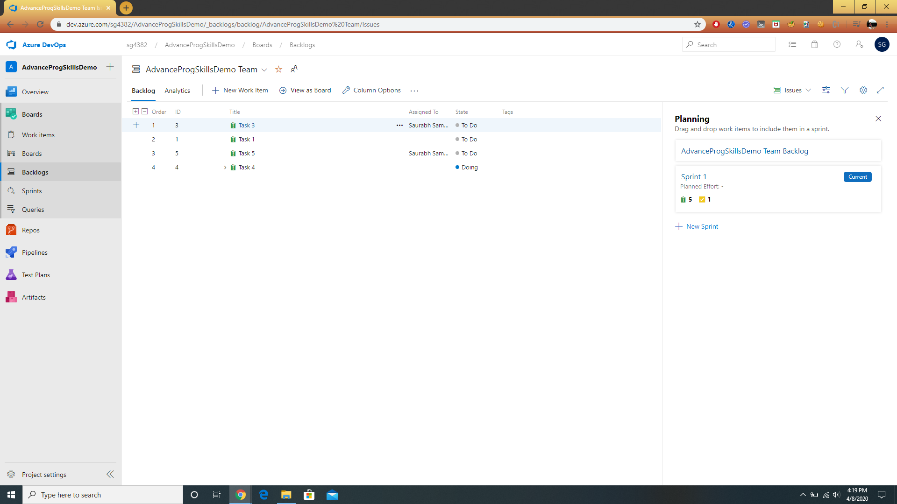
Backlog view.
Click on Backlogs.

Slide 25
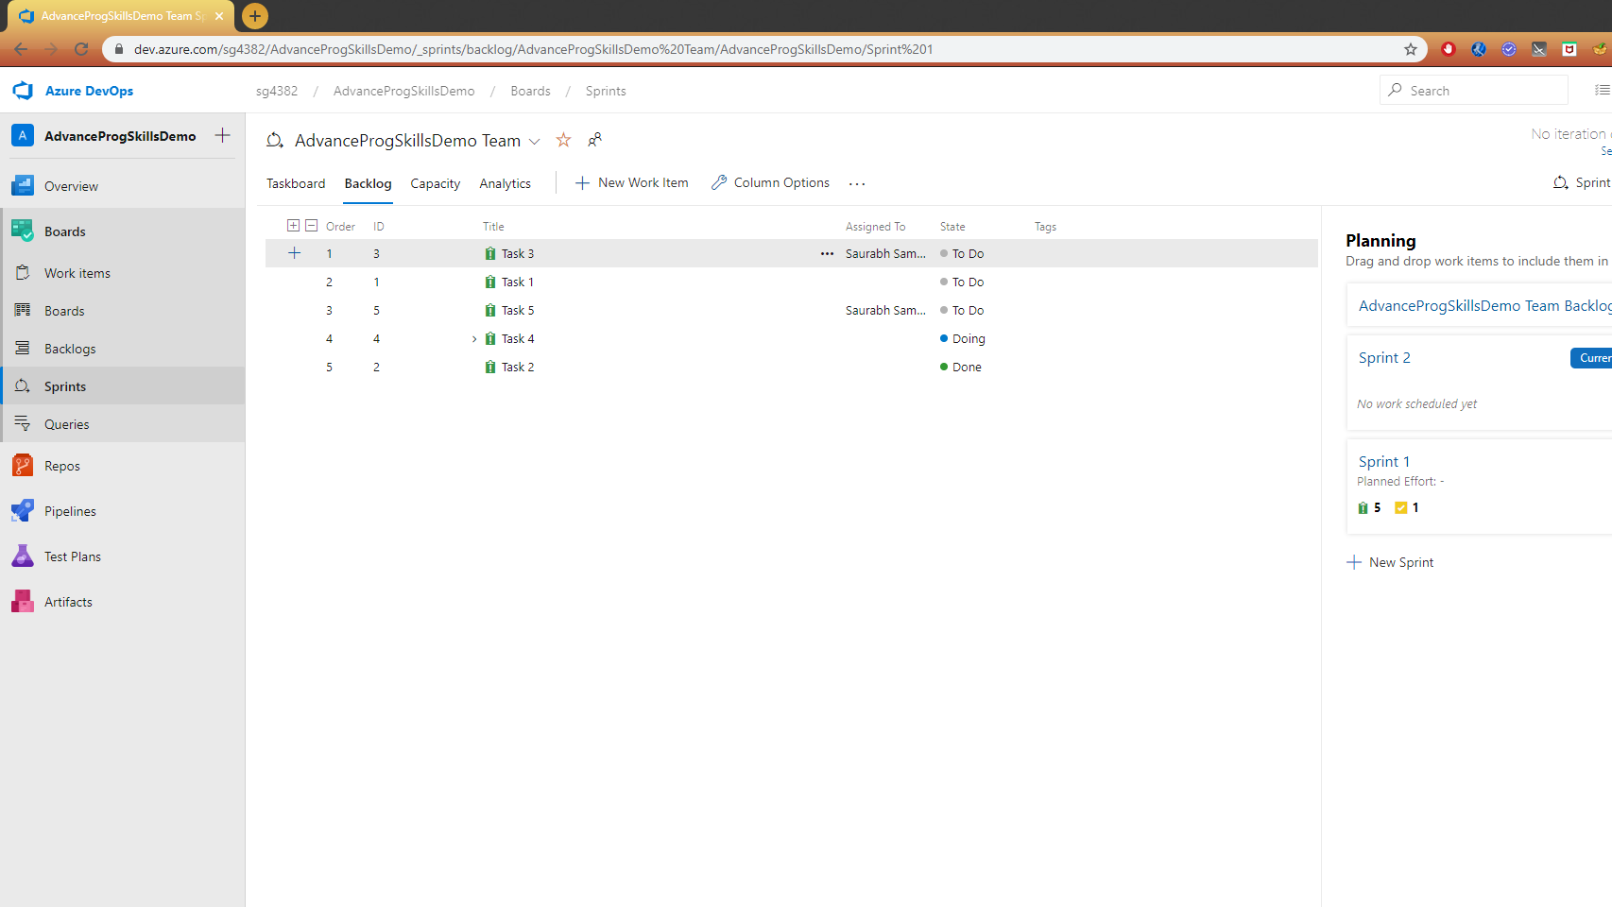
Add sprint to Planning by clicking New Sprint.
Sprint -> 2-3 weeks cycle is called Sprint.

Slide 26
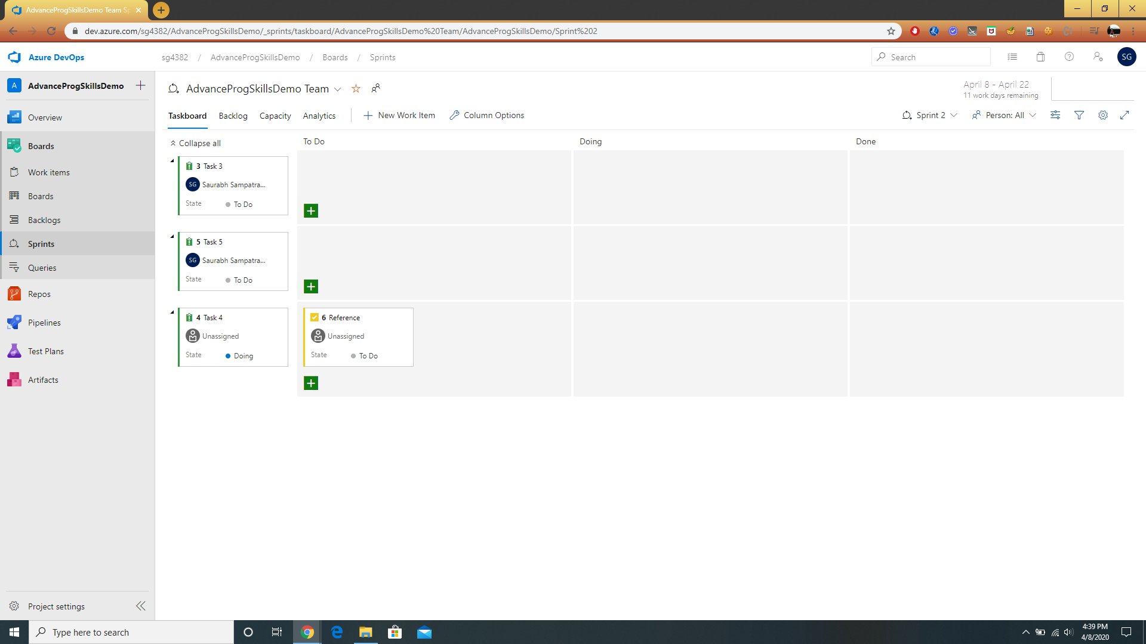
Taskboard view.

Slide 27
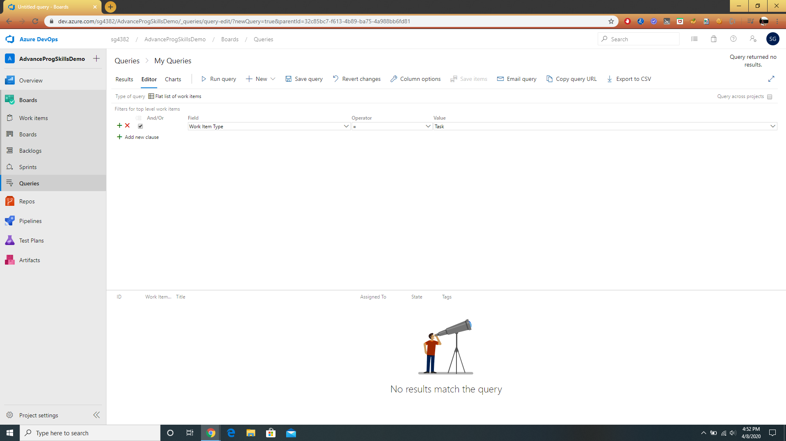
We can run query and find the tasks.

Slide 28
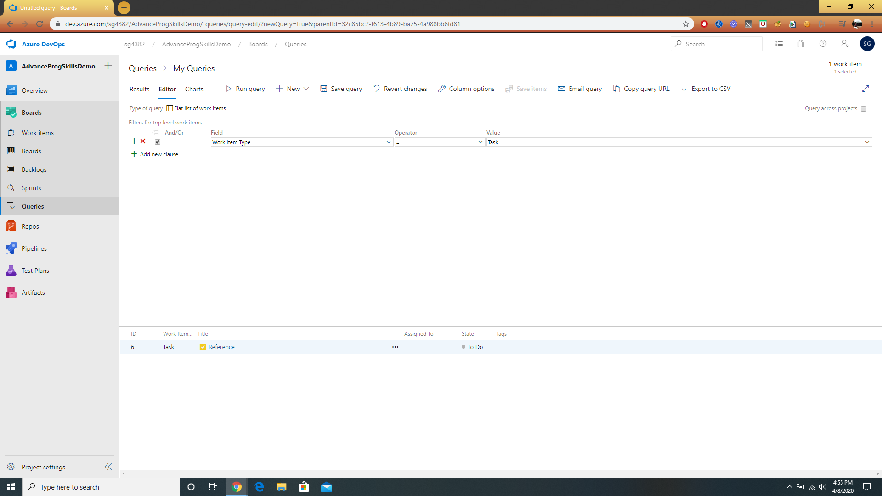
Resulting query.

Slide 29
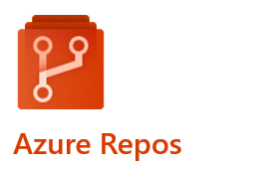
Azure DevOps
Repos

Slide 30
Azure Repos
If you are writing code, then you need a place to store and manage that code with a reliable version control system like Git. Azure Repos provides one of the best in class Git solutions. With Azure Repos you get free private and public repos, social code reviews, and more. In this video we will walk you on how to get started with Git in Azure Repos and how your team can use pull requests to work together to collaborate on code.

Slide 31
Why do we need Repos?
It helps in collaborating to build better code. Performs more effectively in Git code reviews with threaded discussion and continuous integration.
We can automate with built-in CI/CD. Protects your code quality with branch policies.

Slide 32
Azure Repo Demo
Creating custom Repos and managing branch policies and commits

Slide 33
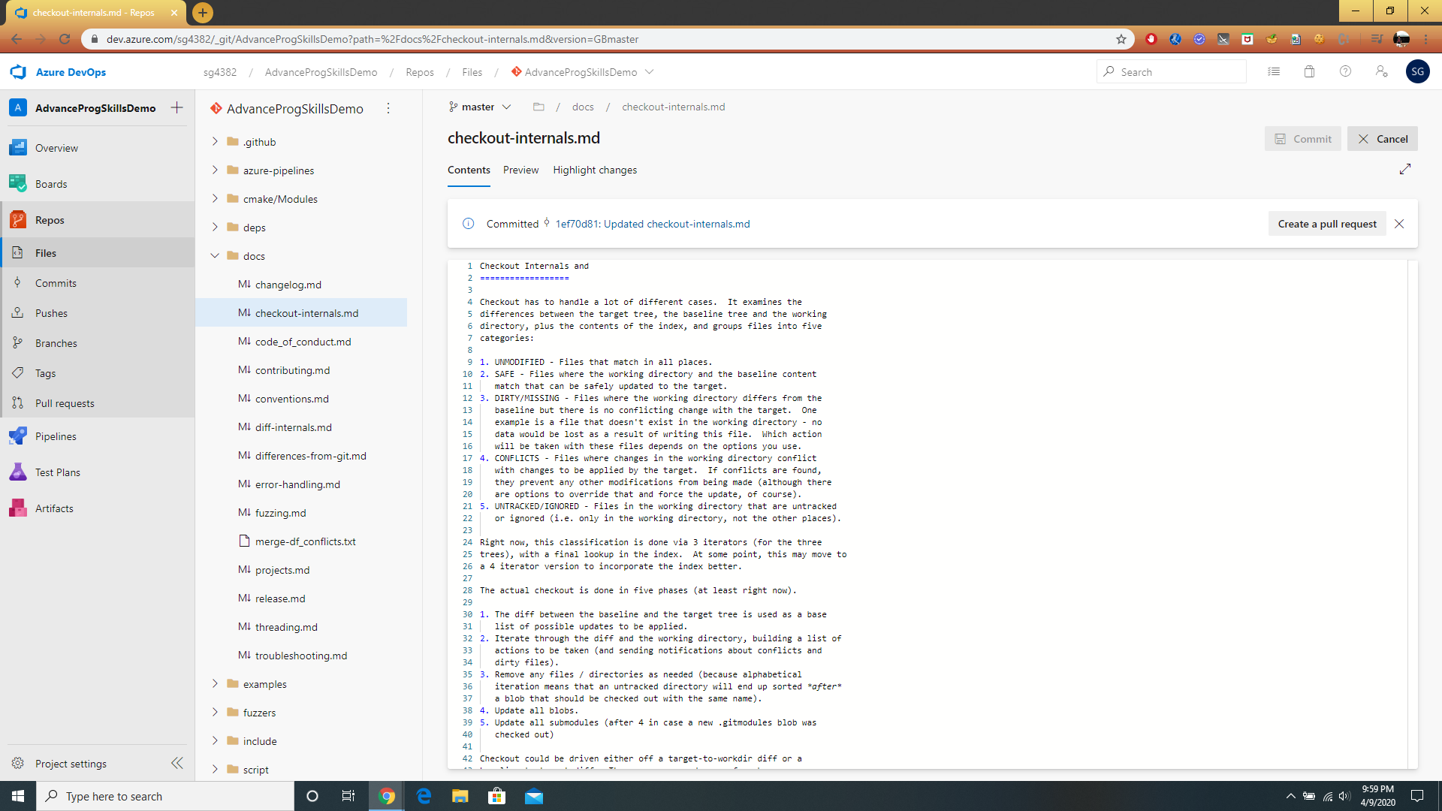
Editing a document on Repos.

Slide 34
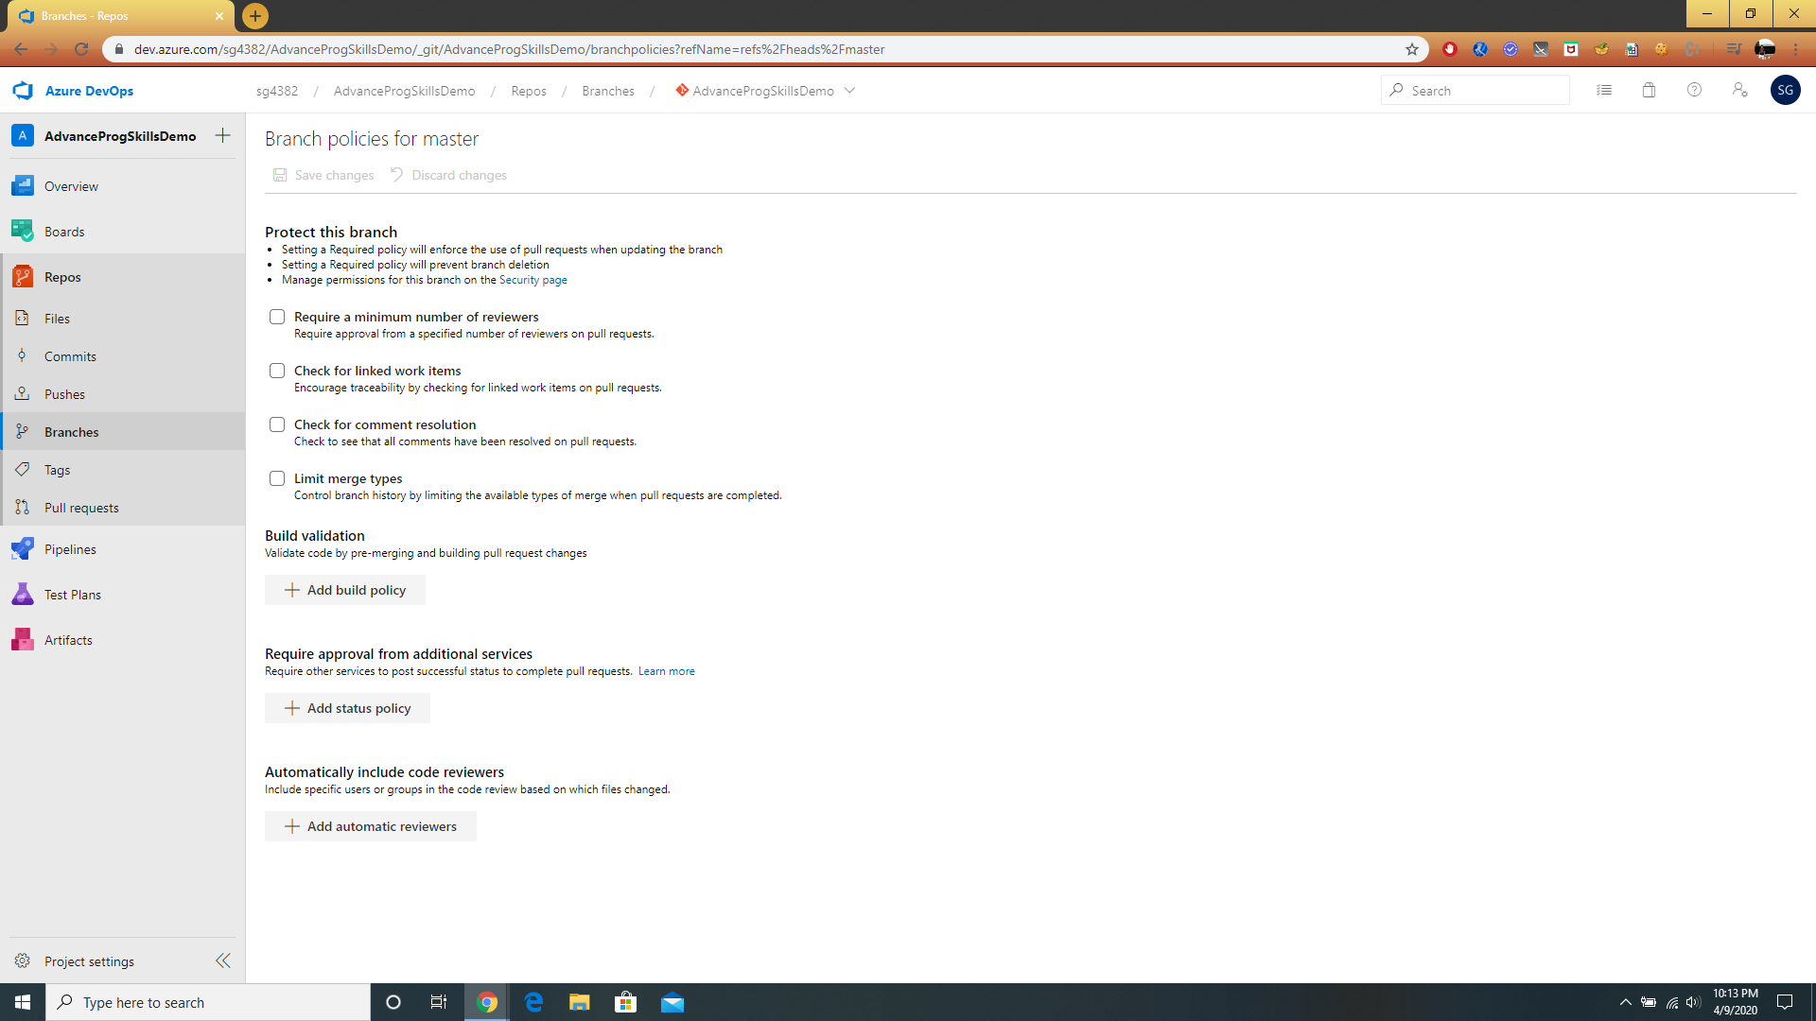
Branch Policies.

Slide 35
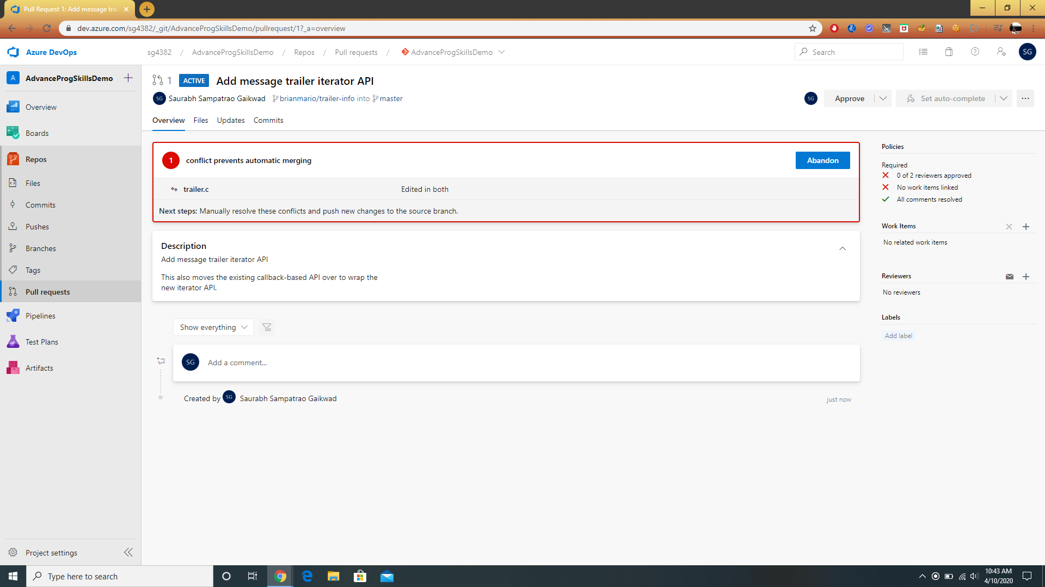
Pull requests, approving and status.

Slide 36
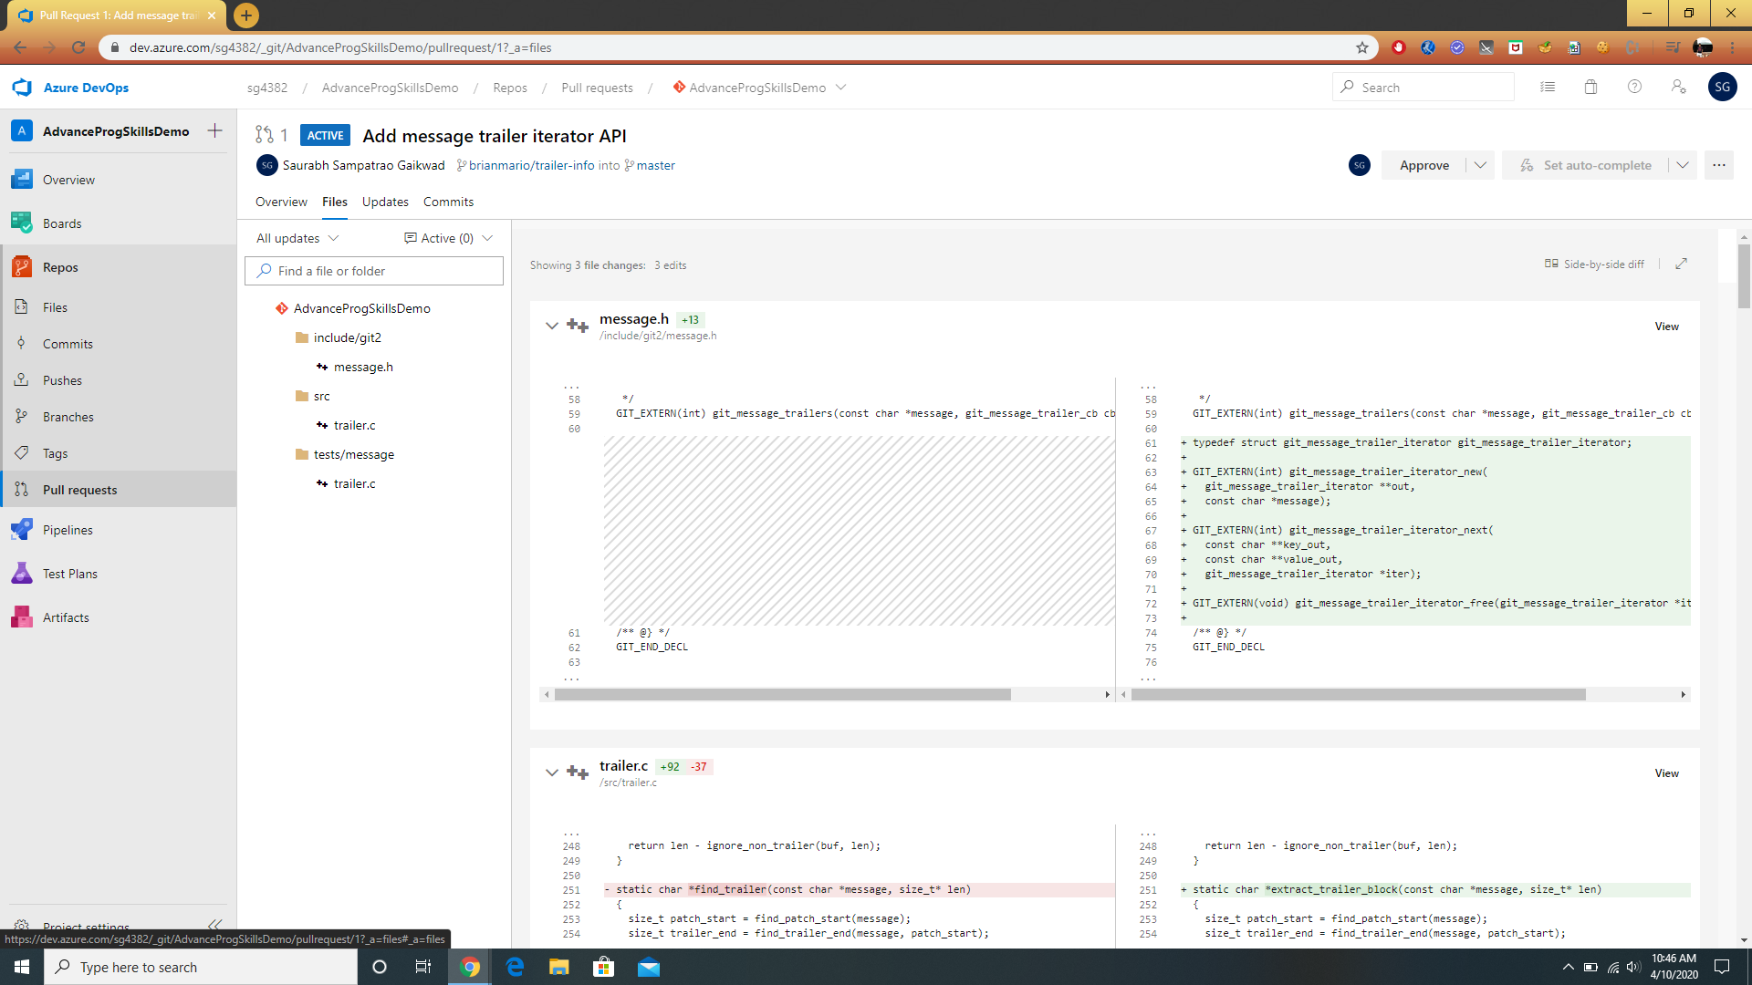
Files changed in Pull request.

Slide 37
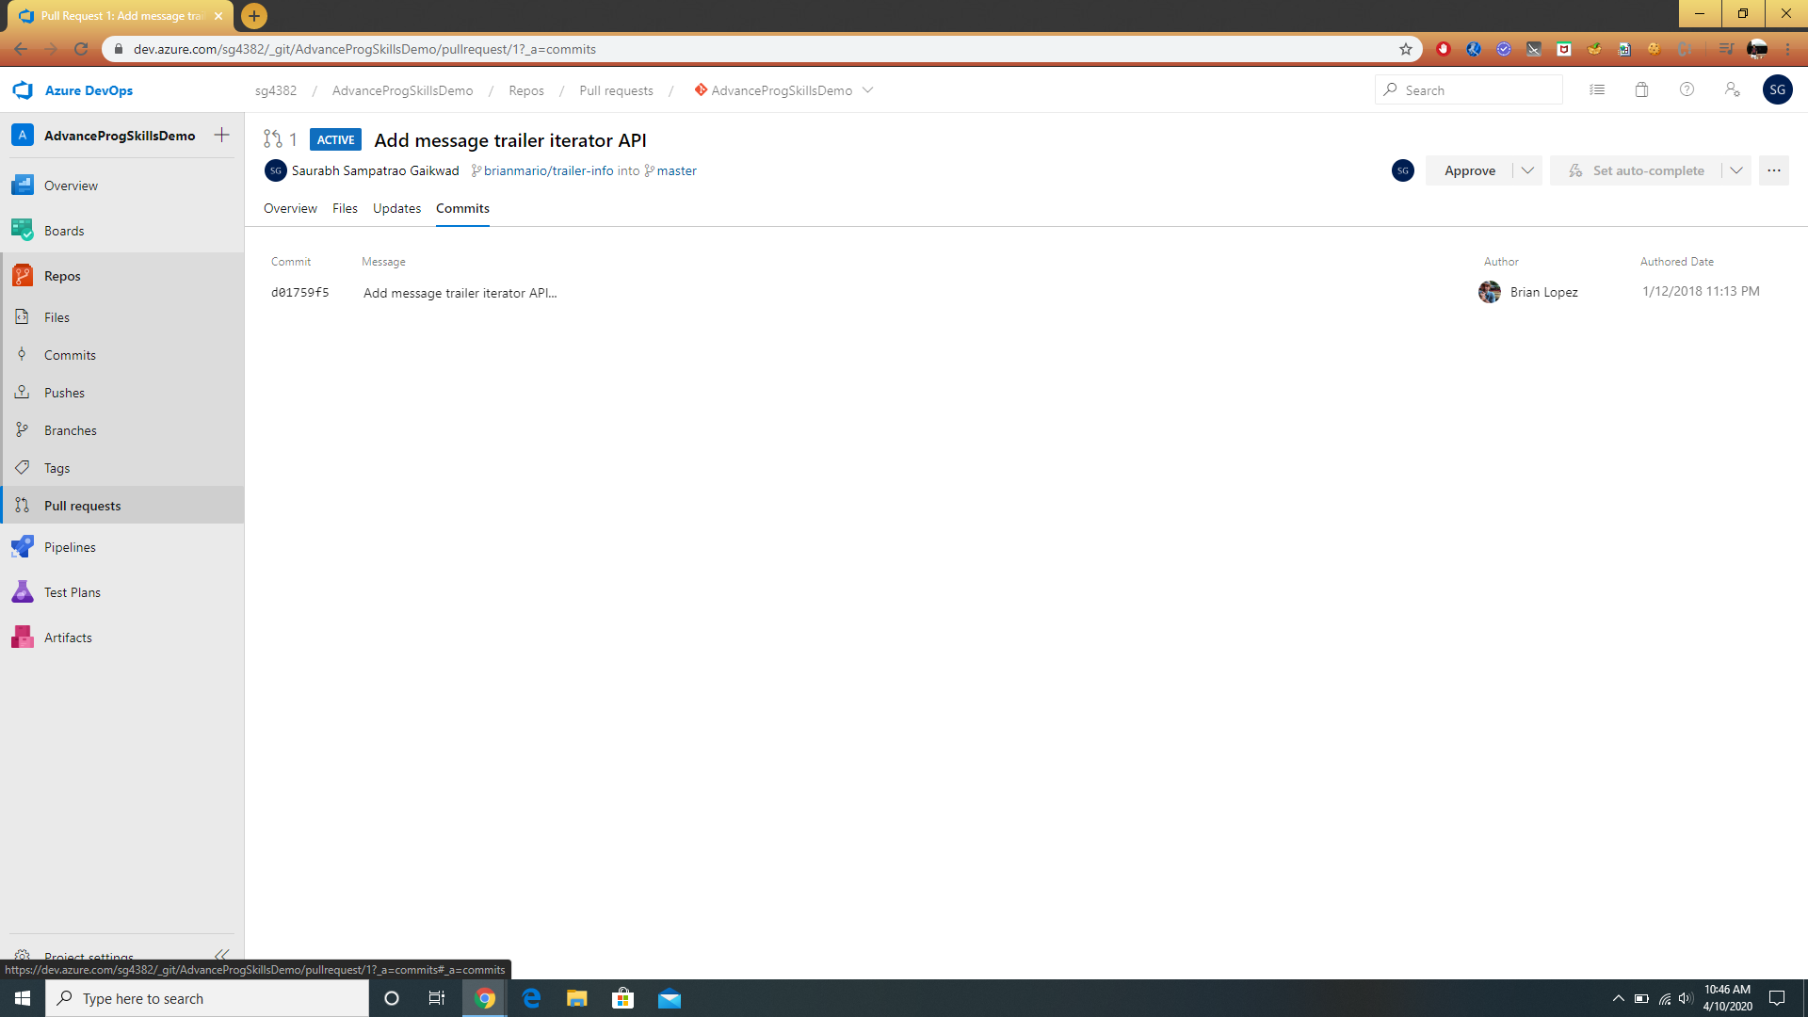
Commits of Pull Request.

Slide 38
Azure Presentation Demo
Creating a CI/CD Pipeline for Github Project and release it on Azure Cloud

Slide 39
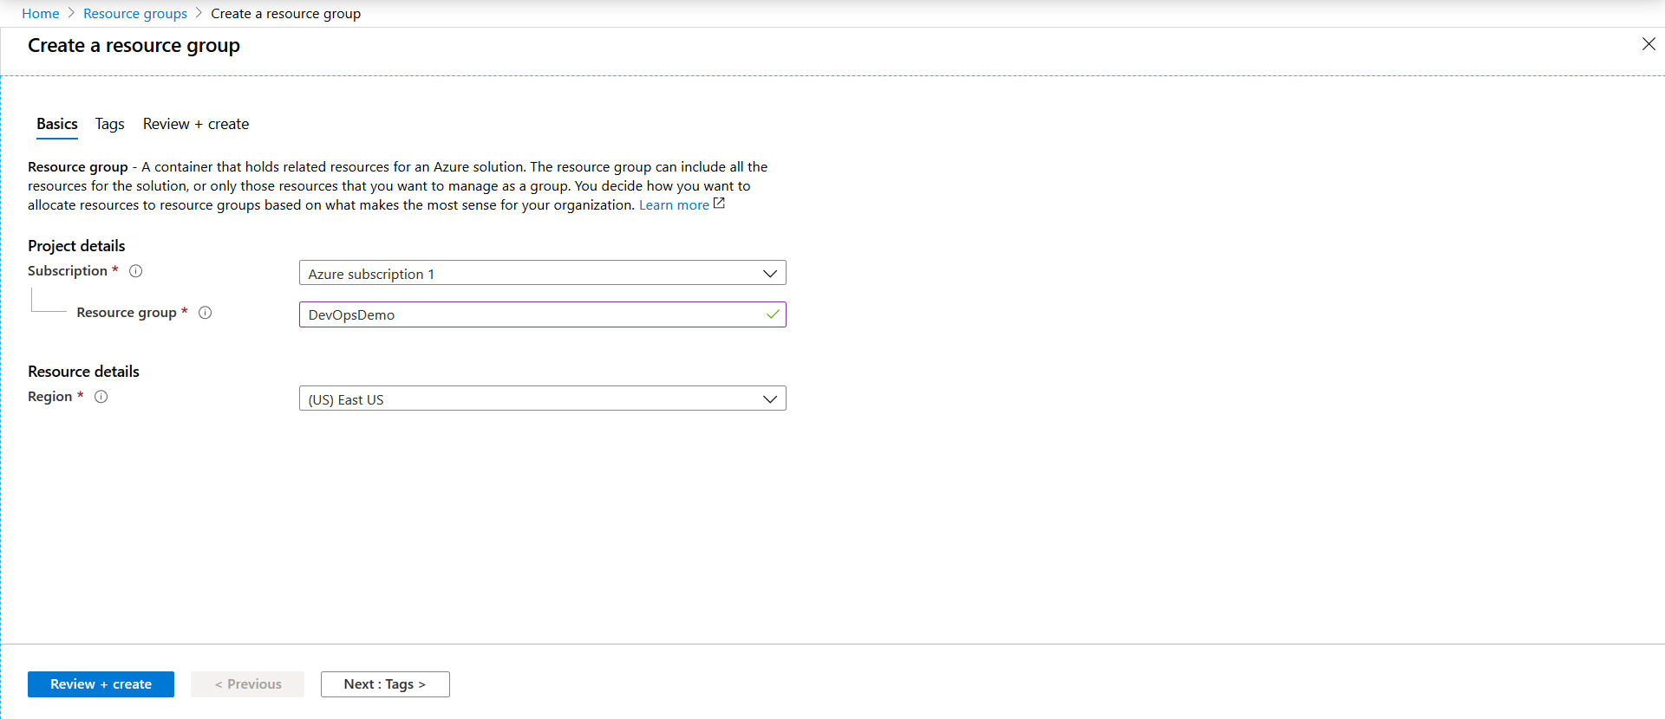
Sign into Azure portal https://portal.azure.com/
In the search tab, search for Resource Group and click on +Add. Create a resource group by some name.

Slide 40
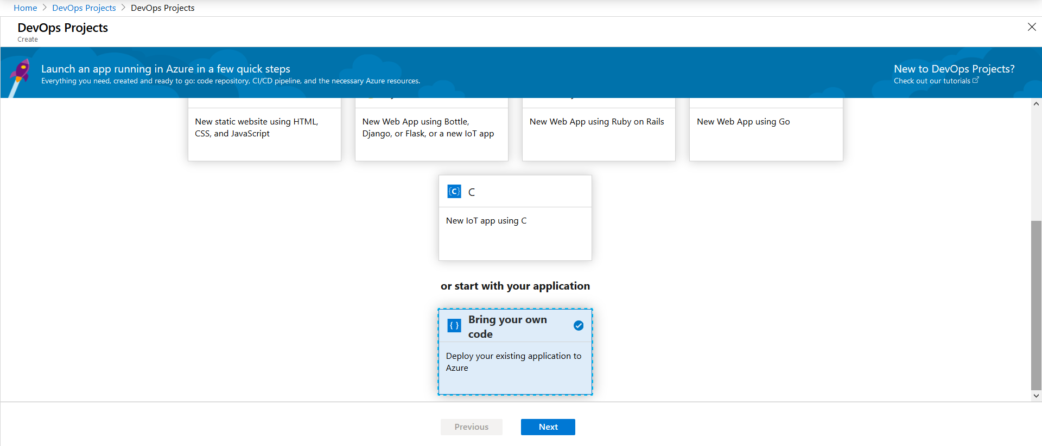
3. In the search tab, search for DevOps Project and click on +Add. We will use Github
repository as a codebase for this Demo. Select “Bring your own code” and follow the steps.

Slide 41
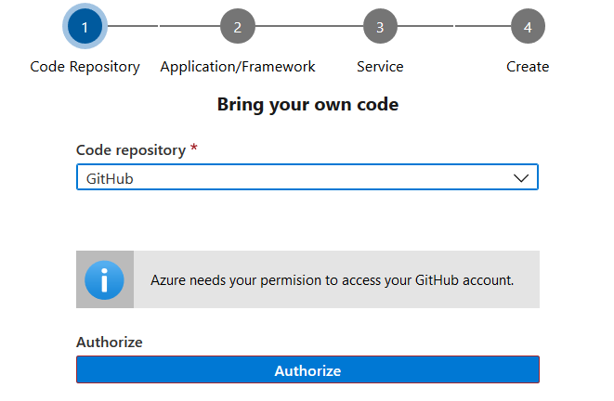
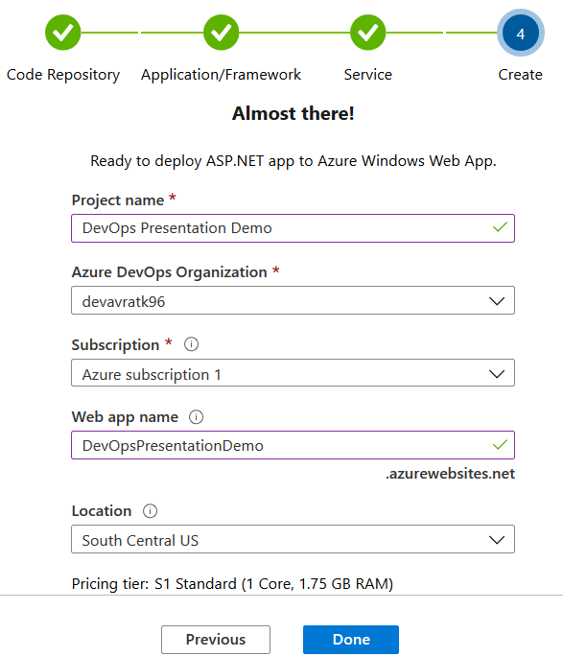
4. Select Github and repository of the project. Follow through instructions click Done.

Slide 42
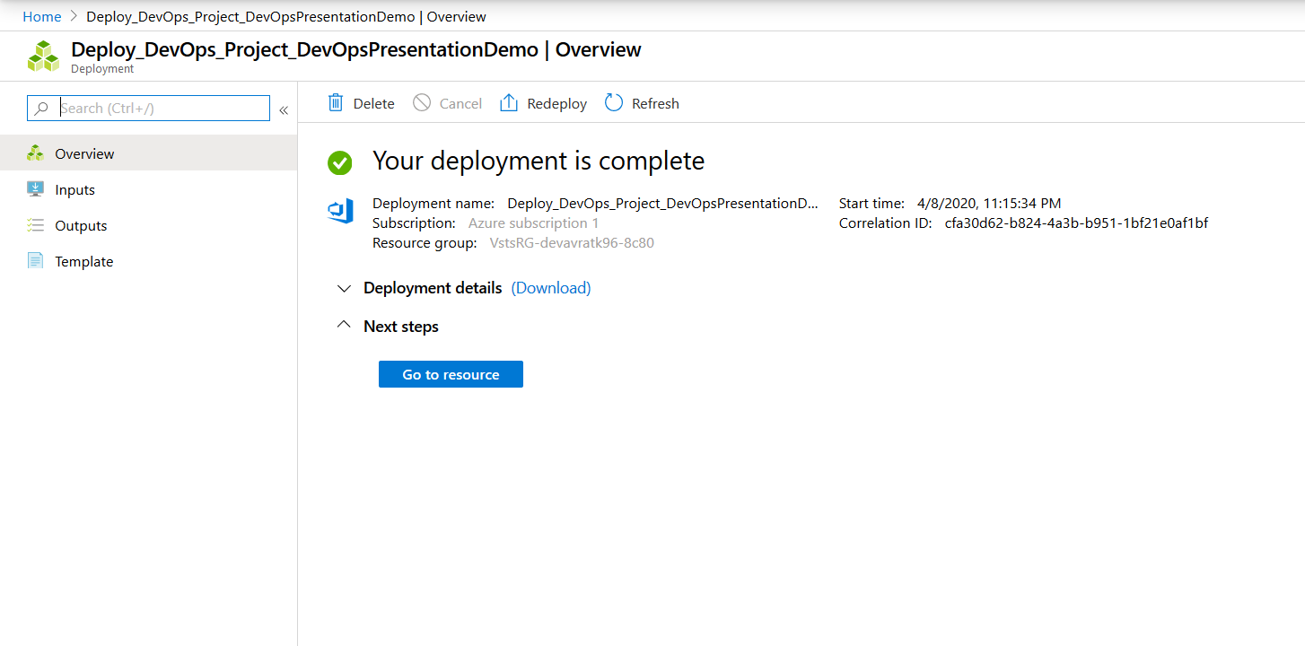
5. Once everything is set, it will take time to create an environment for the project and start
building your project. Click on “Go to resources”.

Slide 43
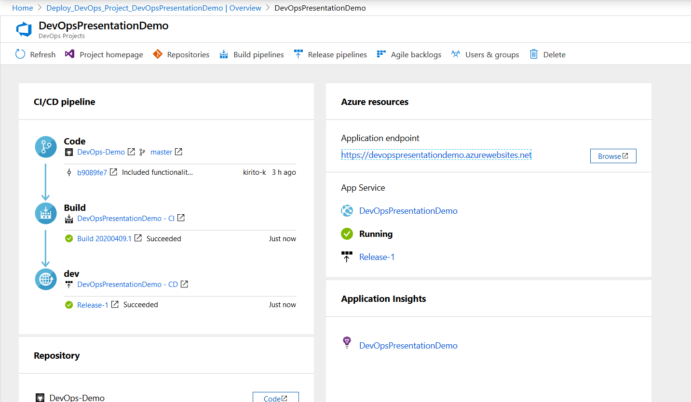
6. We can see the progress of every stage i.e. Code, Build, Dev while it is in progress.

Slide 44
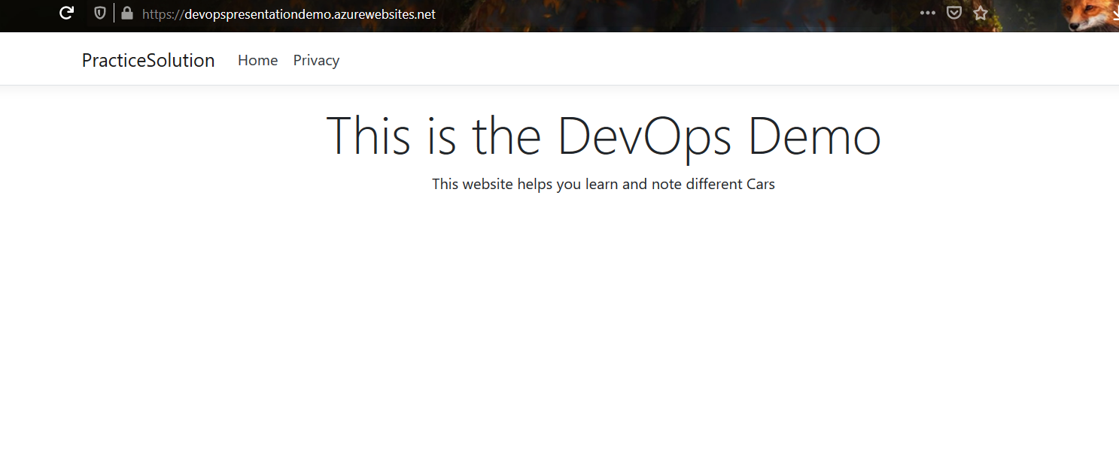
7. Once all stages are complete we can access this website using Application endpoint link.

Slide 45
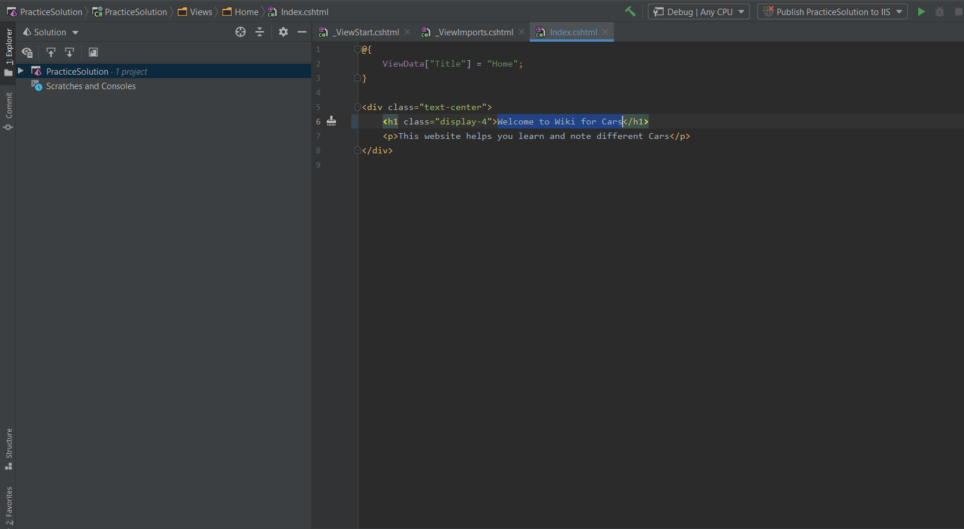
8. To check whether pipeline is working properly Change the codebase locally and push it to
Github.

Slide 46
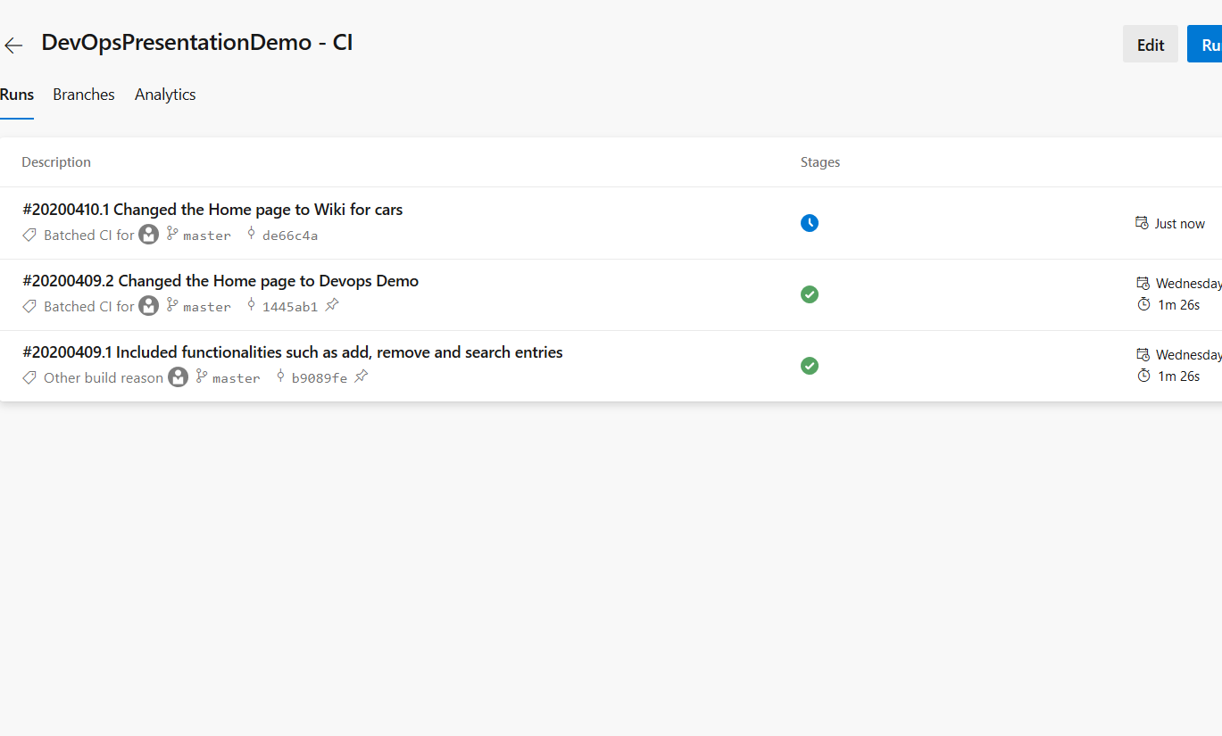
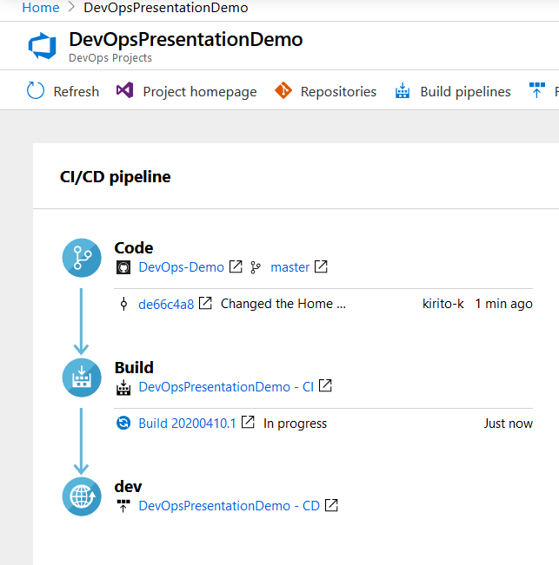
9. You can see the changes are in progress on our Azure DevOps Project Portal as well as
Pipelines

Slide 47
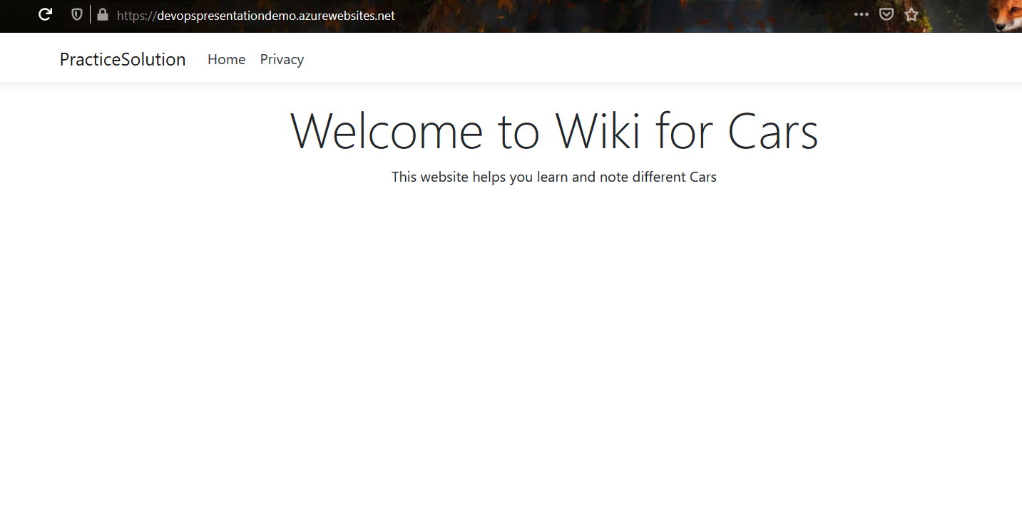
10. After everything is set, the results will be reflected directly on our web URL.

Slide 48
References
Azure DevOps Documentation
Azure DevOps in Action by Callon Campbell
AWS DevOps
The Agile Admin

Slide 49
Thank you

